Slide 1
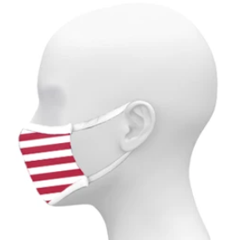
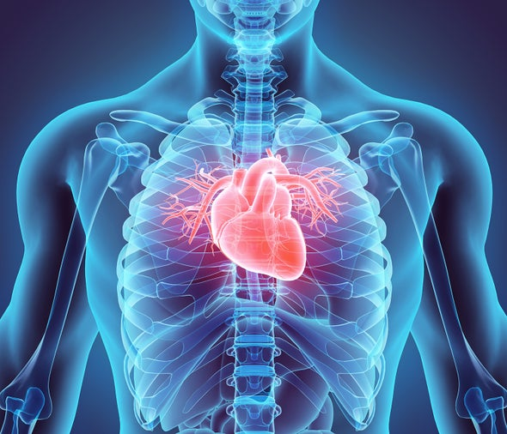
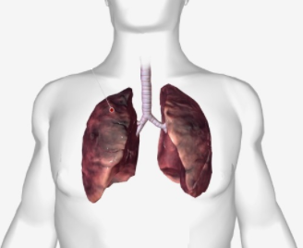
Proposed Network Architecture
Input
224 x 224 x 3
Pretrained
VGG16
VGG19
ResNet50
Inceptionv3
Xception
Covid Negative
Image Preprocessing & Data Augmentation
Covid Positive
Average Pooling
Dense & SoftMax
Flatten layer
Notes:
Ajarn here we simply explain that we take an input image and pass through 3 CNN layers to extract the local features information.
These features information are passed through primary capsule to extract the detailed information as well as location and size of that feature and
Finally apply through routing by agreement or voting procedure that have high probability to select that feature information.
Finally apply capsule featured information on Fully connected layer with softmax to classified the x-ray input image as Covid negative, Covid positive or Viral Pneumonia.

